Slide 1
HOUSING AND NEIGHBORHOOD WORKING GROUP
8 August 2019 – Today’s Agenda (Call #2)
Recap of HNWG call 1
Presentation by Ying Long
  Overview of neighborhood and health approach for Beijing
Operationalizing the Health and Housing framework
    Health outcomes and variables
Data requests
  Assessment of relevant data sources
    Accra and London data sources table
    Other partner cities
  Contact person for each partner city

Slide 2
HOUSING AND NEIGHBORHOOD WORKING GROUP
Call #1 Recap (11 July 2019)
Introductions
Brief presentation – work in progress by housing & health team
  Overview of approach / major activities
  Review of literature
  Development of framework
  Data analysis
    Accra census (challenges with neighborhood definition)
    London data
Discussion on goals for working group:
  Need to find actionable decisions on relevant domains of housing and neighborhood, beyond the work on housing/neighborhood and health frameworks.
  Need to define the logistics, contact persons, and next steps for the working group and upcoming calls.

Slide 3
Neighbourhoods and Health
Housing and Neighbourhoods Working Group
8 August 2019
Ying Long, Tsinghua University

Slide 4
Operationalizing the Health and Housing framework
Housing and Neighbourhoods Working Group
8 August 2019
Gary Adamkiewicz, HSPH
Judith Rodriguez, HSPH
Bethlehem Solomon, Imperial

Slide 5
Overview
Issue | Key health effects
Household air pollution [pollutants from stoves using kerosene, biomass (wood, animal dung and crop waste) and coal] | Stroke, ischemic heart disease, chronic obstructive pulmonary disease (COPD) and lung cancer. Close to half of deaths due to pneumonia among children under 5 years of age are caused by particulate matter (soot) inhaled from household air pollution. (WHO)
Environmental tobacco smoke | Cardiovascular and respiratory diseases, including coronary heart disease and lung cancer. In infants, ETS exposure raises the risk of sudden infant death syndrome. In pregnant women, it causes pregnancy complications and low birth weight. Second-hand smoke causes more than 1.2 million premature deaths per year, and 65,000 children die each year from illnesses attributable to second-hand smoke. (WHO)
Dampness and mold | Increased risk of respiratory symptoms, respiratory infections and exacerbation of asthma. Some evidence suggests increased risks of allergic rhinitis and asthma. Clinical evidence has shown that exposure to mould and other dampness-related microbial agents increases the risks of rare conditions, such as hypersensitivity pneumonitis, allergic alveolitis, chronic rhinosinusitis and allergic fungal sinusitis.
Lead exposure | Wide range of toxic effects. Based on 2015 data, lead exposure is estimated to account for 12.4% of the global burden of idiopathic intellectual disability, 2.5% of the global burden of IHD, 2.4% of the global burden of stroke, 4.4% of hypertensive heart disease, 0.8% of rheumatic heart disease and 1.4% of other cardiovascular diseases worldwide.
Overcrowding | Close-contact infectious diseases (e.g., tuberculosis (TB), flu-related hospitalizations and illnesses, pneumonia, acute respiratory illness, respiratory syncytial virus, gastroenteritis and diarrheal diseases, etc.)
Low indoor temperatures | Respiratory morbidity and mortality (e.g., studies show association with lung function in asthmatics and those with COPD); Cardiovascular morbidity and mortality (e.g., studies show association with blood pressure)
High indoor temperatures | All-cause mortality (outdoor temperature), heat stroke, hyperthermia, dehydration, hospital admission (cardiovascular and respiratory). Climate-specific results widely observed.
Injury hazards | Burns (home fires; smoke alarms); Injury in children (stair and safety gates; window guards)
Water quality (and poor sanitation) | Infectious disease (cholera, diarrhea illnesses, dysentery, hepatitis A, typhoid and polio); Pollutant-related disease (e.g., lead)

Slide 6
Data requests
  Assessment of relevant data sources
    Accra and London data sources table
    Other partner cities
  Contact person for each partner city
Data source
Ghana Statistical Service (GSS), Ghana Health Service (GHS), and ICF. 2018. Ghana Maternal Health Survey 2017.
Ghana Statistical Service (GSS), Ministry of Finance and Economic Planning. Population and Housing Census 2010.
Ghana Statistical Service (GSS). Ghana Living Standards Survey (GLSS) 2017.
Ghana Statistical Service (GSS), Ghana Health Service (GHS), and ICF International. 2015. Ghana Demographic and Health Survey 2014. Rockville, Maryland, USA: GSS, GHS, and ICF International.
United Nations Children's Fund (UNICEF), Multiple Indicator Cluster Survey (MICS) with an Enhanced Malaria Module and Biomarker, 2011.
Institute of Statistical, Social and Economic Research (ISSER), (2011). Ghana-Accra, Multiple Indicator Cluster Survey in 5 High Densely Populated Localities, 2010-2011. Final Report, Accra, Ghana. ISSER.
Accra
Data source
UK Census (10% sample)
English Housing Survey
UK Energy Performance Certificates (EPC)
Living Costs and Food Survey (LCFS)
Time Use Survey (TUS)
Understanding Society (previously British Household Panel Survey)
Ordnance Survey (OS) (e.g., Topography Layer, Site Layer)
English Index of Multiple Deprivation (IMD)
London

Slide 7
Overview
Issue | Variables (by household) | Data Source
Household air pollution [pollutants from stoves using kerosene, biomass (wood, dung and crop waste) coal] | {COOKING_FUEL; COOKING_SPACE; RUBBISH disposal; LIQUID_WASTE disposal ^{}1} {Cooking fuel} ² {Clean Fuels SDG 7.2.1} ³ | 1 - Ghana Population and Housing Census 2010. 2 - Ghana Demographic and Health Survey 2014. 3 - UNICEF Multiple Indicator Cluster Survey (MICS) 2017-18.
Environmental tobacco smoke | {Frequency of smoking in the home (incl. second hand smoke); Mother’s smoking status (cigarettes/tobacco); Smoking status (cigarettes/tobacco); Uses tobacco} ¹ | 1- Ghana Demographic and Health Survey 2014.
Overcrowding | {ROOMS household occupy; BEDROOMS household occupy; SHARING of sleeping room with other hholds; SHARING sleeping room; ENUMMALESFEMALES total persons; YEARS_RESIDENT, SINCEBIRTH; HOUSEHOLD TYPE; DWELLING TYPE; TENURE; OWNERSHIP} ¹ {Share facilities with other households; Number of households sharing toilet; Number of rooms used for sleeping; Babies in the household; Other non-family members in household; Other temporal visitors in household} ² {Household composition, Number of usual members}³ | 1- Ghana Population and Housing Census 2010. 2- Ghana Maternal Health Survey 2017. 3- Ghana Demographic and Health Survey 2014.
Water quality (and poor sanitation) | {WATER_DRINKING; WATER_SOURCE; TOILET; SHARING TOILET; SHARING TOILET Number of households}¹ , {Drinking water source; Water source for cooking/handwashing; Location water source} ², {Basic Drinking Water, Sanitation & Hygiene Services (SDG 1.4.1/6.2.1)} ³ {Drinking water source; water cooking/handwashing; Source Location; Time to obtain drinking water; treatment drinking water}⁴ | 1- Ghana Population and Housing Census 2010. 2- Ghana Maternal Health Survey 2017. 3- UNICEF MICS 2017-18. 4- Ghana Demographic and Health Survey 2014.
etc.
Structure | {Outer WALLS material; FLOOR material; ROOF material; DWELLING TYPE} ¹ {Main floor material; Main roof material; Main wall material} ² {Main floor material; Main roof material; Main wall material} ³ | 1- Ghana Population and Housing Census 2010. 2- Ghana Demographic and Health Survey 2014. 3- Ghana Maternal Health Survey 2017.
etc.

Slide 8
Data Sources Table
Data source | Description | Variables (e.g.) | Time
Ghana Statistical Service (GSS), Ghana Health Service (GHS), and ICF. 2018. Ghana Maternal Health Survey 2017. | Survey designed to provide data for monitoring the maternal health situation in Ghana. A nationally representative sample of 25,062 women age 15-49 in 26,324 households was interviewed. | Similar to census; Household demographics; Drinking water sources; Toilet facilities; Detailed flooring/roofing info, etc. | Every 10 years; Most recent: 2017, since 2007.
United Nations Children's Fund (UNICEF), Multiple Indicator Cluster Survey (MICS) with an Enhanced Malaria Module and Biomarker, 2011. | Sample size 12,886 households. The MICS was originally developed in response to the World Summit for Children to measure progress towards an internationally agreed set of mid-decade goals. The first round of MICS was conducted around 1995 in more than 60 countries. The more frequent surveys provide the opportunity for countries to capture rapid changes in key indicators, particularly the MDGs. | Indicators on: child mortality, nutrition, child health, maternal and newborn health, HIV and Aids, water and sanitation (improved water sources, improved sanitation facility), child protection | Initially about every 5-10 years, since 2009 at more frequent intervals - every three years: 1995 (dataset not available), 2006 (dataset available), 2007-08 (district, dataset not available), 2011 (dataset available), 2017-18 (data processing)
Each partner city submits assessment of relevant data sources

Slide 9
Housing Quality Standards review
National Healthy Housing Standard
The seven chapters
1. Duties of Owners and Occupants
1.1. Duties of Owners
1.2. Duties of Occupants
2. Structures, Facilities, Plumbing, and Space Requirements
2.1. Structure
2.2. Facilities
2.3. Plumbing System
2.4. Kitchen
2.5. Bathroom
2.6. Minimum Space
2.7. Floors and Floor Coverings
2.8. Noise
3. Safety and Personal Security
3.1. Egress
3.2. Locks/Security
3.3. Smoke Alarm
3.4. Fire Extinguisher
3.5. Carbon Monoxide Alarm
3.6. Walking Surfaces
3.7. Guards
3.8. Chemical Storage.
3.9. Pools, Hot Tubs, and Other Water Features
4. Lighting and Electrical Systems
4.1. Electrical System
4.2. Outlets
4.3. Natural Lighting
4.4. Artificial Lighting
5. Thermal Comfort, Ventilation, and Energy Efficiency
5.1. Heating, Ventilation, and Air Conditioning Systems
5.2. Heating System
5.3. Ventilation
5.4. Air Sealing
6. Moisture Control, Solid Waste, and Pest Management
6.1. Moisture Prevention and Control
6.2. Solid Waste
6.3. Pest Management
7. Chemical and Radiological Agents
7.1. General Requirements
7.2. Lead-Based Paint
7.3. Asbestos
7.4. Toxic Substances in Manufactured Building Materials
7.5. Radon
7.6. Pesticides
7.7. Methamphetamine
7.8. Smoke in Multifamily Housing
Poor Quality Index (PQI)
Electricity problems (15 points maximum)
Unit does not have electricity
Unit has exposed wiring
Unit does not have electric plugs in every room
Each occurrence of a blown fuse or thrown circuit breaker
Heating problems (32 points maximum)
Unit was uncomfortably cold for 24+ hours
Each heating equipment breakdown
Unit cold due to utility interruption
Unit cold due to inadequate heating capacity
Unit cold due to inadequate insulation
Unit cold due to other reason
Main heating equipment is unvented kerosene heater(s)
Inside structural or other problems (22 points maximum)
Water leak in roof
Water leak in wall or closed door/window
Water leak in basement
Water leak from other source
Inside leak from leaking pipes
Inside leak from plumbing fixtures
Inside leak from other or unknown source
Holes in the floor
Open cracks wider than a dime
Peeling paint larger than 8 by 11 inches
Evidence of rodents
Bathroom problems (16 points maximum)
Unit does not have hot and cold running water OR Unit does not have a bathtub
shower OR Unit does not have a flush toilet
Each breakdown leaving unit without a toilet for 6+
American Housing Survey (AHS)
“Core” Housing Subjects:
Housing costs and value
Housing age, type, size, amenities
Housing quality and neighborhood characteristics
Mortgage characteristics
Home improvements
Household income and demographics
Disabilities
Migration
Plumbing, water, and sewage
Review of standards, surveys, tools, and criteria used in US and UK, as well as metrics to measure housing quality.
Healthy Homes Rating System (HHRS)
Physiological
• Dampness & Mold Growth
• Excess Cold
• Excess Heat
• Asbestos and manmade fibers
• Biocides
• Carbon Monoxide
• Lead-based paint
• Radiation
• Uncombusted fuel
• Volatile organic compounds
Psychological
• Crowding and Space
• Entry by Intruders
• Lighting
• Noise
Infection
• Domestic Hygiene, etc.
• Food Safety
• Personal Hygiene
• Water Supply
Safety
• Falls in baths etc.
• Falls on the level
• Falls on stairs etc.
• Falls from windows, etc.
• Electrical hazards
• Fire hazards
• Hot surfaces, etc.
• Collision/Entrapment
• Ergonomics
• Explosions
• Structural collapse
Housing Quality Indicator (UK)
indicators:
location
site – visual impact, layout and landscaping
site – open space
site – routes and movement
unit – size
unit – layout
unit – noise, light, services and adaptability
unit – accessibility within the unit
unit – sustainability
external environment
Kitchen problems (10 points maximum)
Unit does not have a refrigerator OR Unit does not have a kitchen sink OR Unit does not have a cook stove or range
Outside structural problems (35 points maximum)
Windows broken
Holes/cracks or crumbling in foundation
Roof has holes
Roof missing shingles/other roofing materials
Outside walls missing siding/bricks/and so on
Roof’s surface sags or is uneven
Outside walls slope/lean/slant/buckle
Water and sewer problems (32 points maximum)
Each time unit is completely without water
Each sewage disposal breakdown
Elevator problems (4 points maximum)
No working elevator in building of four or more stories
Notes:
Adding variables table- in progress
Missing:
2011 and 2013 AHS Study on Quality of Assisted Housing (summary note)
HQI Calculator (UK)

Slide 10
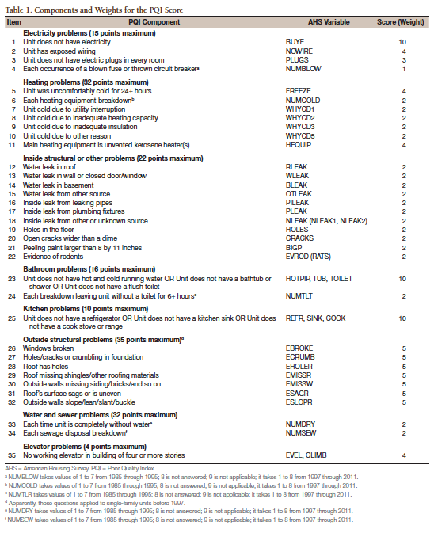
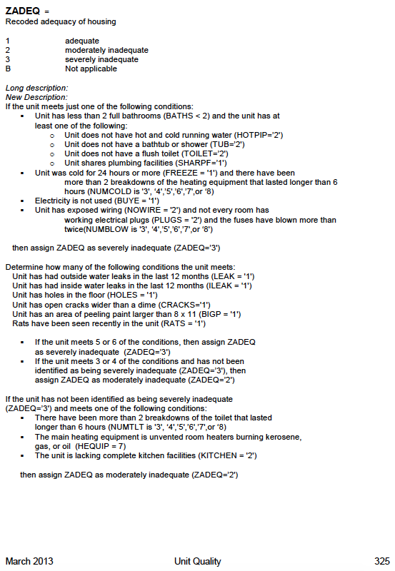
Notes:
Adding variables table- in progress
Missing:
2011 and 2013 AHS Study on Quality of Assisted Housing (summary note)
HQI Calculator (UK)

Slide 11
Data requests
  Contact person for each partner city

Slide 12
Next steps
Upcoming calls
  Sep 12
  Oct 10
  Nov 14
  Dec 12

Slide 13
Thank You

