Slide 1
HOUSING AND NEIGHBORHOOD WORKING GROUP
Call #2 Recap (8 August 2019)
Brief presentation by Y. Long – work in progress by neighborhood & health team
Relationship between neighborhood and housing outcomes
Definition of neighborhood by each city, potential pathways and relationship to health outcomes
Development of framework for neighborhood (transportation, work, leisure, social media…)
Density measures, floor area ratio, diversity performance, diversity from function, playability, walkability, streetscapes, greenspace, distance to transit
Operationalizing housing/neighborhood and health frameworks
What are the outcomes that can be collapsed together?
i.e. High/low temperatures into thermal comfort
Which ones are missing? i.e. noise
Which ones should not be here?
Which ones belong to neighborhood? i.e. pollutants of outdoor origin
Assessment of city data sources: Creation of a consistent database for the relevant housing and neighborhood variables
Starting with set of candidate variables that can be implemented in other cities
What it is that is relevant to quality? Measures of quality
Do cities want to work on cost? (affordability) Is data on housing costs available?
Work from Dr. Paul Kershaw (Emily’s suggestion)
Check for availability of data
Empiricism and policy relevance
Discussion on goals for working group:
Concerns on how housing/neighborhood and health frameworks will be used
What to measure and in what form in a city and what data sources?
Action Items
Priority 1 for Everyone: Master document summarizing datasets (Accra, Beijing, Dhaka, London, Vancouver).
Priority 2 for Everyone Add related variables and source for each city.
Ying's team - List of key issues (neighborhood) for

Slide 2
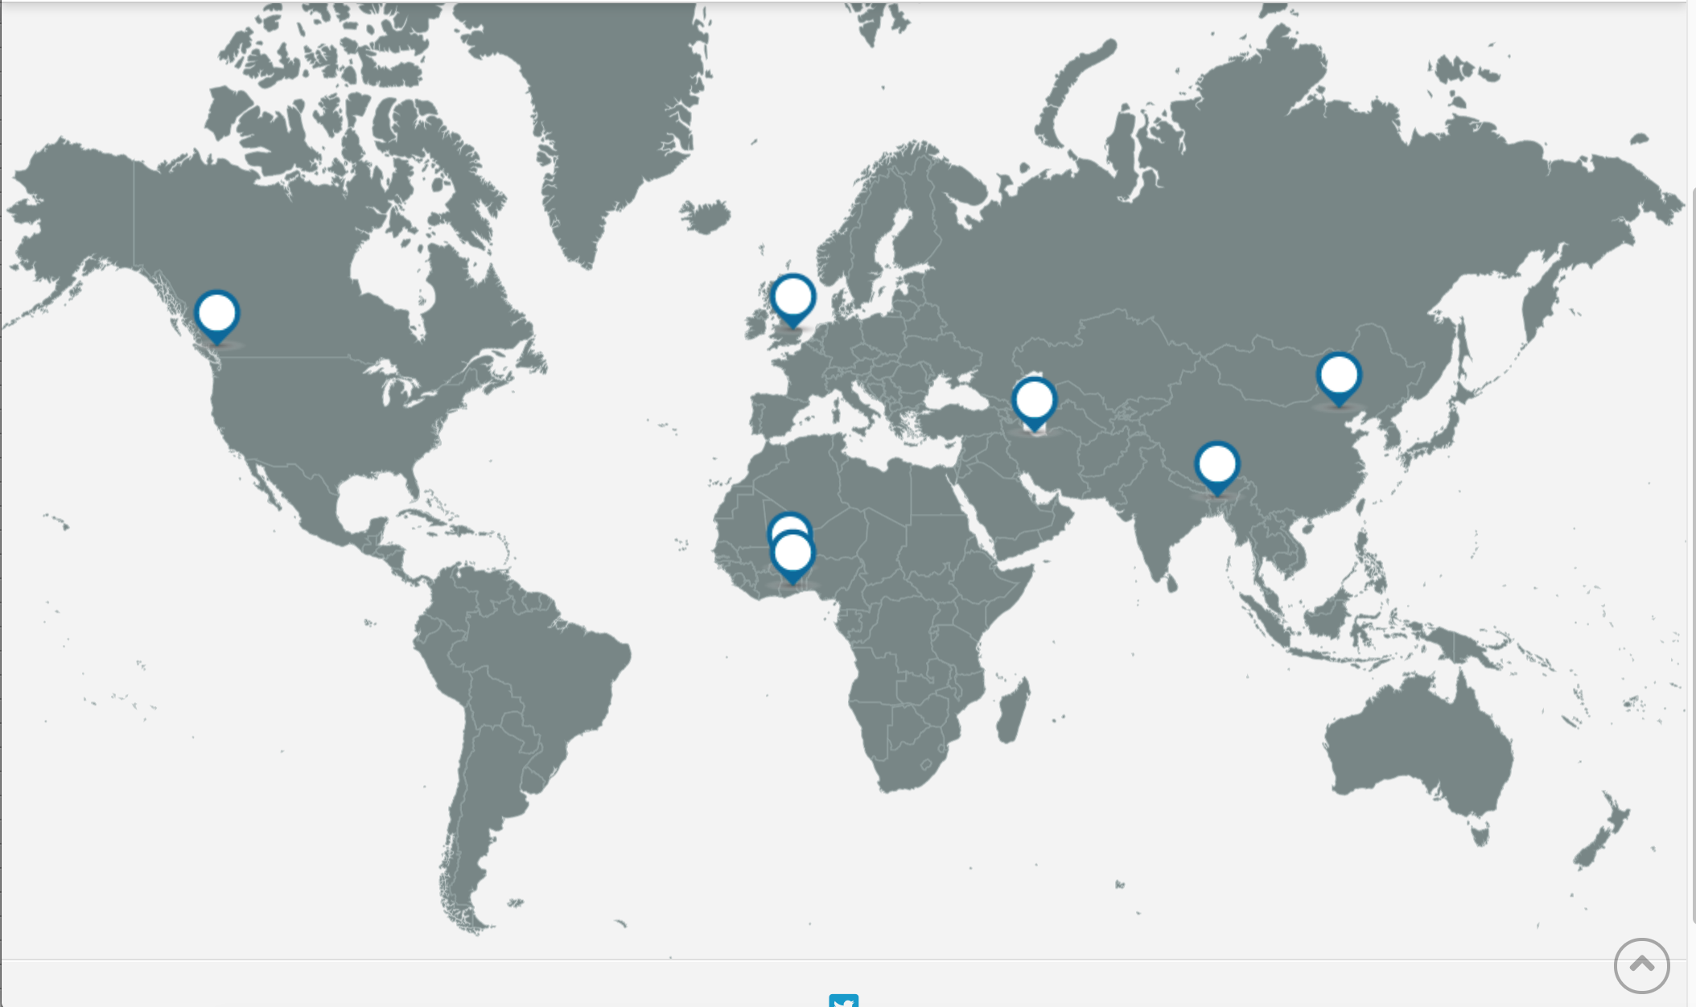
Operationalizing data into a Housing and Health index
Housing and Neighbourhoods Working Group
12 September 2019
Gary Adamkiewicz, HSPH
Judith Rodriguez, HSPH
Bethlehem Solomon, Imperial

Slide 3
HOUSING AND NEIGHBORHOOD WORKING GROUP
12 September 2019 – Today’s Agenda (Call #3)
Recap of HNWG call # 2
Status of relevant data sources from city partners
Discussion of commonalities / challenges
Operationalizing data into a Housing and Health index
Example of index assignment based on Accra data
Quick overview of housing quality indices
Next steps
Workshop in Accra
October 9-10

Slide 4
Assessment of data sources
Actions
The housing group has summarized a list of key housing issues that impact health for review by the H&N WG.
As of September 6, the city partners provided information of the data sources available in their cities.
Ongoing
Help city partners to work with their data to create indices, match variables to key issues, which will help to provide guidance to city partners on next steps.
Challenges
Variability in the kinds of data from city partners
Variability in the census responses

Slide 5
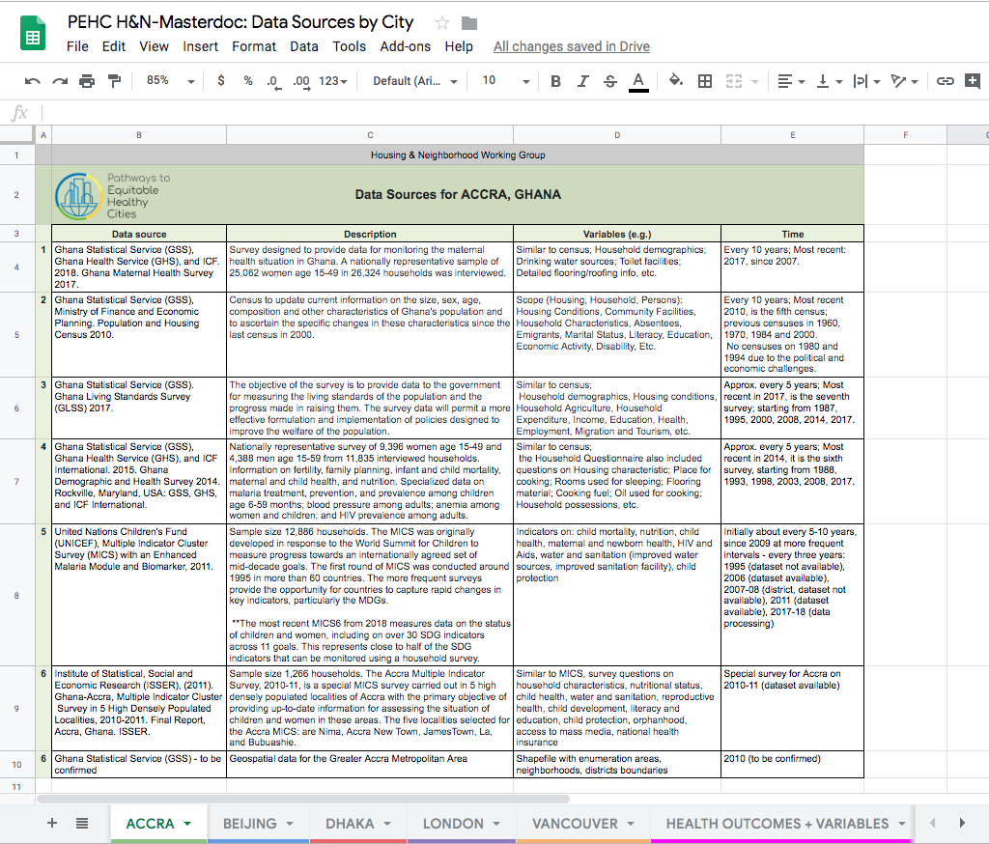
Master document
https://docs.google.com/spreadsheets/d/1Za95cno-q1xVQI62nmZIOXTOr8UNB2WafRjW3D_Zz-A/edit?usp=sharing

Slide 6
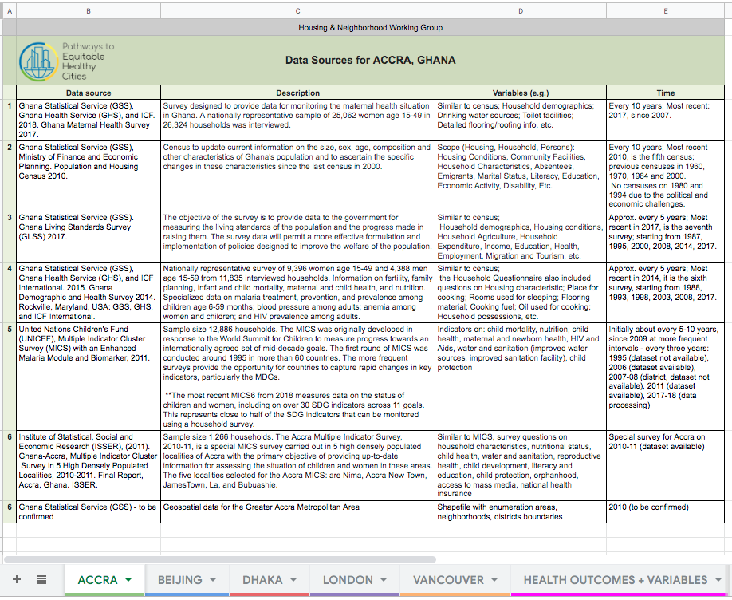
Accra

Slide 7
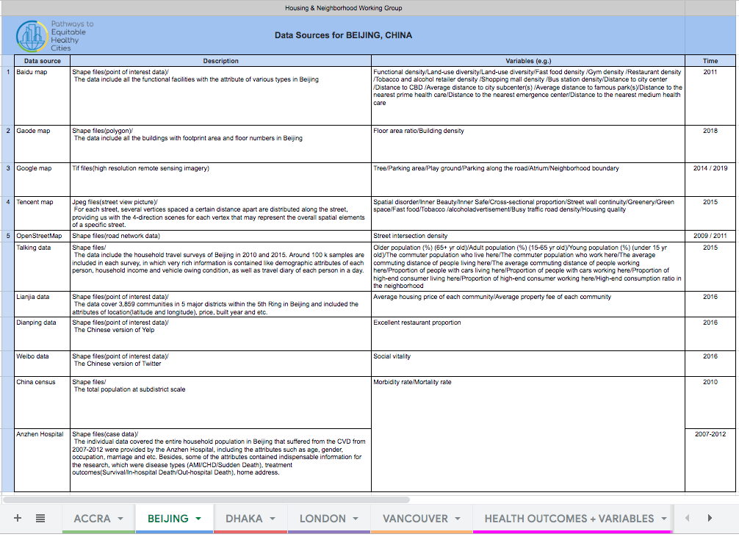
Beijing

Slide 8
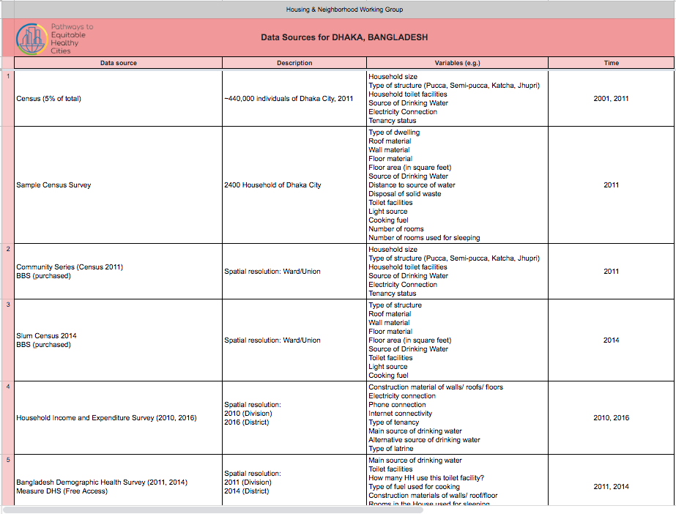
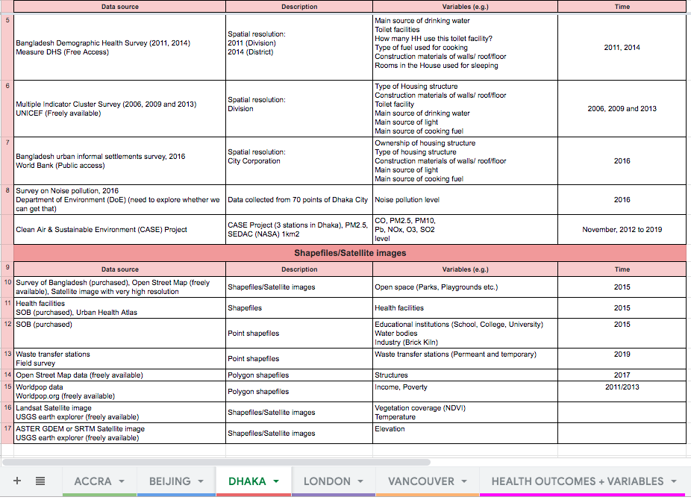
Dhaka

Slide 9
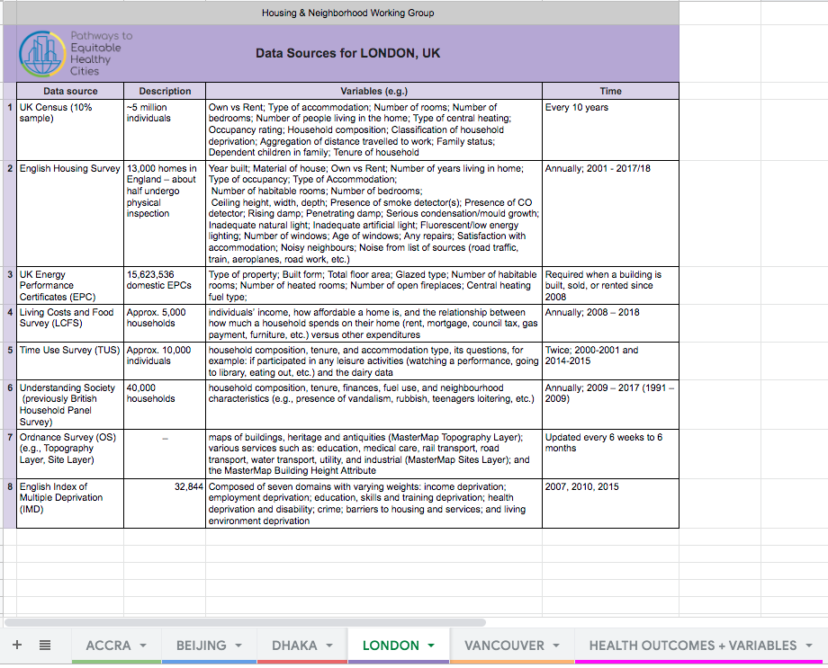
London

Slide 10
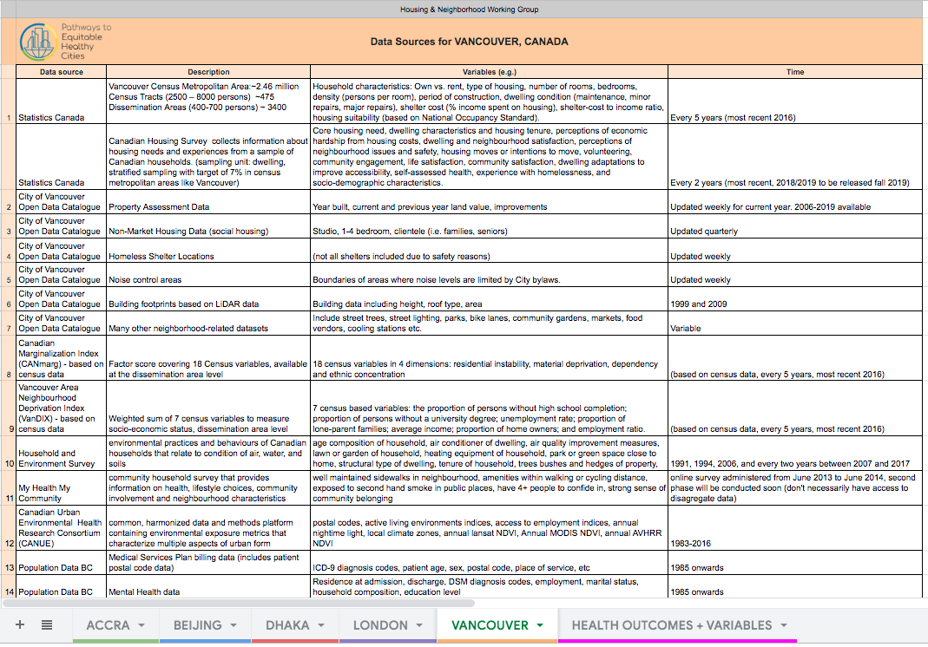
Vancouver

Slide 11
Overview
Issue | Key health effects
Household air pollution [pollutants from stoves using kerosene, biomass (wood, animal dung and crop waste) and coal] | Stroke, ischemic heart disease, chronic obstructive pulmonary disease (COPD) and lung cancer. Close to half of deaths due to pneumonia among children under 5 years of age are caused by particulate matter (soot) inhaled from household air pollution. (WHO)
Environmental tobacco smoke | Cardiovascular and respiratory diseases, including coronary heart disease and lung cancer. In infants, ETS exposure raises the risk of sudden infant death syndrome. In pregnant women, it causes pregnancy complications and low birth weight. Second-hand smoke causes more than 1.2 million premature deaths per year, and 65,000 children die each year from illnesses attributable to second-hand smoke. (WHO)
Dampness and mold | Increased risk of respiratory symptoms, respiratory infections and exacerbation of asthma. Some evidence suggests increased risks of allergic rhinitis and asthma. Clinical evidence has shown that exposure to mould and other dampness-related microbial agents increases the risks of rare conditions, such as hypersensitivity pneumonitis, allergic alveolitis, chronic rhinosinusitis and allergic fungal sinusitis.
Lead exposure | Wide range of toxic effects. Based on 2015 data, lead exposure is estimated to account for 12.4% of the global burden of idiopathic intellectual disability, 2.5% of the global burden of IHD, 2.4% of the global burden of stroke, 4.4% of hypertensive heart disease, 0.8% of rheumatic heart disease and 1.4% of other cardiovascular diseases worldwide.
Overcrowding | Close-contact infectious diseases (e.g., tuberculosis (TB), flu-related hospitalizations and illnesses, pneumonia, acute respiratory illness, respiratory syncytial virus, gastroenteritis and diarrheal diseases, etc.)
Low indoor temperatures | Respiratory morbidity and mortality (e.g., studies show association with lung function in asthmatics and those with COPD); Cardiovascular morbidity and mortality (e.g., studies show association with blood pressure)
High indoor temperatures | All-cause mortality (outdoor temperature), heat stroke, hyperthermia, dehydration, hospital admission (cardiovascular and respiratory). Climate-specific results widely observed.
Injury hazards | Burns (home fires; smoke alarms); Injury in children (stair and safety gates; window guards)
Water quality (and poor sanitation) | Infectious disease (cholera, diarrhea illnesses, dysentery, hepatitis A, typhoid and polio); Pollutant-related disease (e.g., lead)

Slide 12
Overview
Issue | Variables (by household) | Data Source
Household air pollution [pollutants from stoves using kerosene, biomass (wood, dung and crop waste) coal] | {COOKING_FUEL; COOKING_SPACE; RUBBISH disposal; LIQUID_WASTE disposal ^{}1} {Cooking fuel} ² {Clean Fuels SDG 7.2.1} ³ | 1 - Ghana Population and Housing Census 2010. 2 - Ghana Demographic and Health Survey 2014. 3 - UNICEF Multiple Indicator Cluster Survey (MICS) 2017-18.
Environmental tobacco smoke | {Frequency of smoking in the home (incl. second hand smoke); Mother’s smoking status (cigarettes/tobacco); Smoking status (cigarettes/tobacco); Uses tobacco} ¹ | 1- Ghana Demographic and Health Survey 2014.
Overcrowding | {ROOMS household occupy; BEDROOMS household occupy; SHARING of sleeping room with other hholds; SHARING sleeping room; ENUMMALESFEMALES total persons; YEARS_RESIDENT, SINCEBIRTH; HOUSEHOLD TYPE; DWELLING TYPE; TENURE; OWNERSHIP} ¹ {Share facilities with other households; Number of households sharing toilet; Number of rooms used for sleeping; Babies in the household; Other non-family members in household; Other temporal visitors in household} ² {Household composition, Number of usual members}³ | 1- Ghana Population and Housing Census 2010. 2- Ghana Maternal Health Survey 2017. 3- Ghana Demographic and Health Survey 2014.
Water quality (and poor sanitation) | {WATER_DRINKING; WATER_SOURCE; TOILET; SHARING TOILET; SHARING TOILET Number of households}¹ , {Drinking water source; Water source for cooking/handwashing; Location water source} ², {Basic Drinking Water, Sanitation & Hygiene Services (SDG 1.4.1/6.2.1)} ³ {Drinking water source; water cooking/handwashing; Source Location; Time to obtain drinking water; treatment drinking water}⁴ | 1- Ghana Population and Housing Census 2010. 2- Ghana Maternal Health Survey 2017. 3- UNICEF MICS 2017-18. 4- Ghana Demographic and Health Survey 2014.
etc.
Structure | {Outer WALLS material; FLOOR material; ROOF material; DWELLING TYPE} ¹ {Main floor material; Main roof material; Main wall material} ² {Main floor material; Main roof material; Main wall material} ³ | 1- Ghana Population and Housing Census 2010. 2- Ghana Demographic and Health Survey 2014. 3- Ghana Maternal Health Survey 2017.
etc.

Slide 13
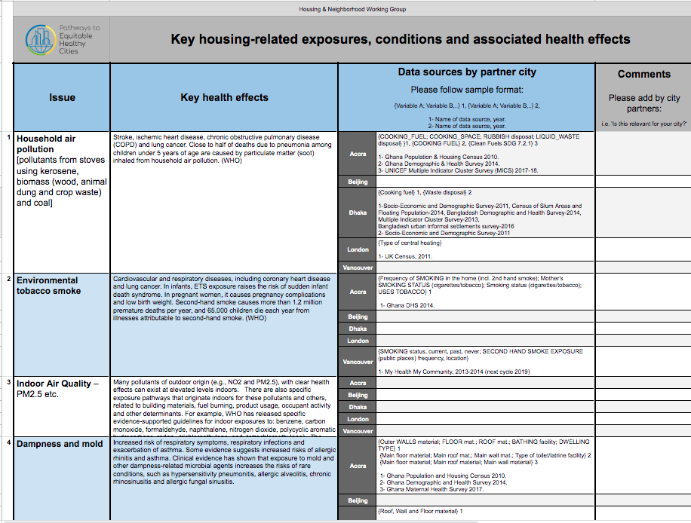
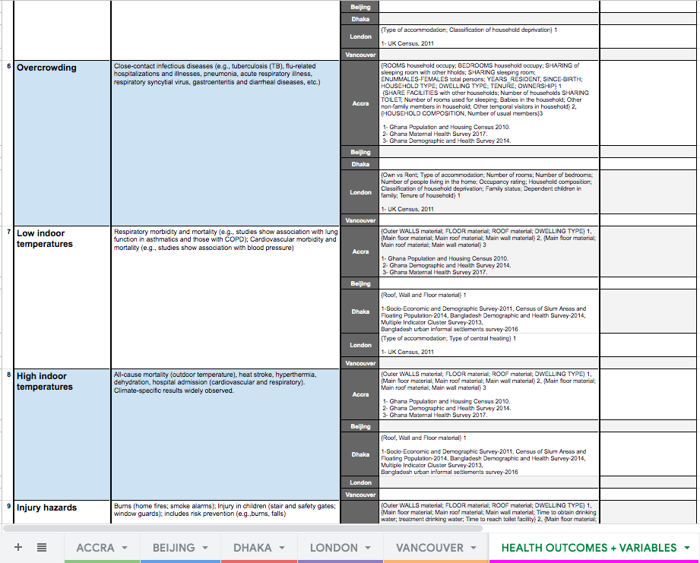
Matching Variables to Health Outcomes

Slide 14
Approaches / philosophy
Approaches
Objectives
Empirical
Resilience
Epidemiological
Health
Regulatory / compliance
Equity
Other aspirational goals…
Exposures / conditions / systems / …
Function
HIERARCHY
Occupancy / function / maintenance of systems / …
Occupancy
Minimum standards / basic conditions / adequacy / …
Structure
Systems
Location

Slide 15
Action
Housing
Dimension | Action
Cost | Average housing price (per m2 and per unit)
 | Average property management fee (per m2 and per unit)
Location | Location indexes (to be developed)
 | Location hidden value
Housing quality | Housing structural attributes (safety, resilience, appearances, materials, etc.)
 | Housing envelope attributes (thermal insulation, ventilation/air tightness, daylighting, acoustical isolation, etc)
 | Housing services system (HVAC system/equipment, water supply, energy system, renewables, cooking exhaust, health enhancing measures, monitoring, alart, etc)
 | Housing usage pattern (identify those that have potentially positive impacts to health)
Indoor Env. Quality | Acoustical disturbances to sleep quality/hyper tension/other health effects
 | Lighting quality and physiological/psychological to people
 | Thermal comfort as a risk factor to CVD
 | Key indoor air quality matrices, exposure, and modeling (using outdoor air quality as B.C.)
 | Indoor air quality reduction/control measures
Housing
Cost
Location
Housing quality
IEQ
Policy Implications:
What have gone wrong in terms of housing quality measures and how to correct them?
How to distinguish between “non-harmful factors” and “health enhancing factors” and promote the latter?
How to create “human-centered” housing environment based on the dynamic human-environment interaction?
How to take advantage of the harmony with the nature in housing design and operation?

Slide 16
Housing Quality Standards review
National Healthy Housing Standard
The seven chapters
1. Duties of Owners and Occupants
1.1. Duties of Owners
1.2. Duties of Occupants
2. Structures, Facilities, Plumbing, and Space Requirements
2.1. Structure
2.2. Facilities
2.3. Plumbing System
2.4. Kitchen
2.5. Bathroom
2.6. Minimum Space
2.7. Floors and Floor Coverings
2.8. Noise
3. Safety and Personal Security
3.1. Egress
3.2. Locks/Security
3.3. Smoke Alarm
3.4. Fire Extinguisher
3.5. Carbon Monoxide Alarm
3.6. Walking Surfaces
3.7. Guards
3.8. Chemical Storage.
3.9. Pools, Hot Tubs, and Other Water Features
4. Lighting and Electrical Systems
4.1. Electrical System
4.2. Outlets
4.3. Natural Lighting
4.4. Artificial Lighting
5. Thermal Comfort, Ventilation, and Energy Efficiency
5.1. Heating, Ventilation, and Air Conditioning Systems
5.2. Heating System
5.3. Ventilation
5.4. Air Sealing
6. Moisture Control, Solid Waste, and Pest Management
6.1. Moisture Prevention and Control
6.2. Solid Waste
6.3. Pest Management
7. Chemical and Radiological Agents
7.1. General Requirements
7.2. Lead-Based Paint
7.3. Asbestos
7.4. Toxic Substances in Manufactured Building Materials
7.5. Radon
7.6. Pesticides
7.7. Methamphetamine
7.8. Smoke in Multifamily Housing
Poor Quality Index (PQI)
Electricity problems (15 points maximum)
Unit does not have electricity
Unit has exposed wiring
Unit does not have electric plugs in every room
Each occurrence of a blown fuse or thrown circuit breaker
Heating problems (32 points maximum)
Unit was uncomfortably cold for 24+ hours
Each heating equipment breakdown
Unit cold due to utility interruption
Unit cold due to inadequate heating capacity
Unit cold due to inadequate insulation
Unit cold due to other reason
Main heating equipment is unvented kerosene heater(s)
Inside structural or other problems (22 points maximum)
Water leak in roof
Water leak in wall or closed door/window
Water leak in basement
Water leak from other source
Inside leak from leaking pipes
Inside leak from plumbing fixtures
Inside leak from other or unknown source
Holes in the floor
Open cracks wider than a dime
Peeling paint larger than 8 by 11 inches
Evidence of rodents
Bathroom problems (16 points maximum)
Unit does not have hot and cold running water OR Unit does not have a bathtub
shower OR Unit does not have a flush toilet
Each breakdown leaving unit without a toilet for 6+
American Housing Survey (AHS)
“Core” Housing Subjects:
Housing costs and value
Housing age, type, size, amenities
Housing quality and neighborhood characteristics
Mortgage characteristics
Home improvements
Household income and demographics
Disabilities
Migration
Plumbing, water, and sewage
Review of standards, surveys, tools, and criteria used in US and UK, as well as metrics to measure housing quality.
Healthy Homes Rating System (HHRS)
Physiological
• Dampness & Mold Growth
• Excess Cold
• Excess Heat
• Asbestos and manmade fibers
• Biocides
• Carbon Monoxide
• Lead-based paint
• Radiation
• Uncombusted fuel
• Volatile organic compounds
Psychological
• Crowding and Space
• Entry by Intruders
• Lighting
• Noise
Infection
• Domestic Hygiene, etc.
• Food Safety
• Personal Hygiene
• Water Supply
Safety
• Falls in baths etc.
• Falls on the level
• Falls on stairs etc.
• Falls from windows, etc.
• Electrical hazards
• Fire hazards
• Hot surfaces, etc.
• Collision/Entrapment
• Ergonomics
• Explosions
• Structural collapse
Housing Quality Indicator (UK)
indicators:
location
site – visual impact, layout and landscaping
site – open space
site – routes and movement
unit – size
unit – layout
unit – noise, light, services and adaptability
unit – accessibility within the unit
unit – sustainability
external environment
Kitchen problems (10 points maximum)
Unit does not have a refrigerator OR Unit does not have a kitchen sink OR Unit does not have a cook stove or range
Outside structural problems (35 points maximum)
Windows broken
Holes/cracks or crumbling in foundation
Roof has holes
Roof missing shingles/other roofing materials
Outside walls missing siding/bricks/and so on
Roof’s surface sags or is uneven
Outside walls slope/lean/slant/buckle
Water and sewer problems (32 points maximum)
Each time unit is completely without water
Each sewage disposal breakdown
Elevator problems (4 points maximum)
No working elevator in building of four or more stories
Notes:
Adding variables table- in progress
Missing:
2011 and 2013 AHS Study on Quality of Assisted Housing (summary note)
HQI Calculator (UK)

Slide 17
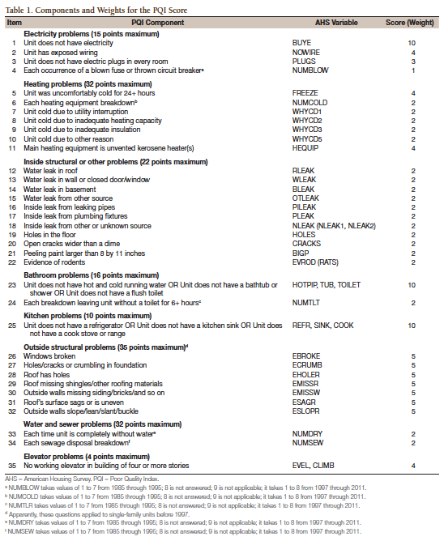
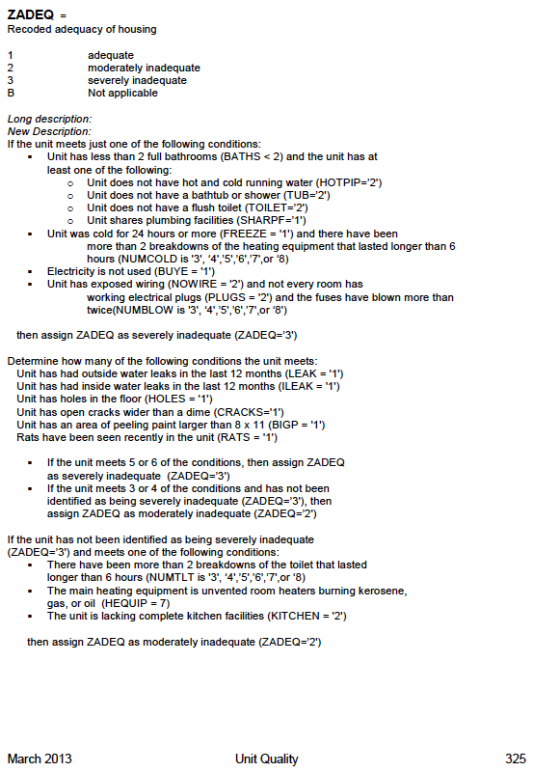
Notes:
Adding variables table- in progress
Missing:
2011 and 2013 AHS Study on Quality of Assisted Housing (summary note)
HQI Calculator (UK)

Slide 18
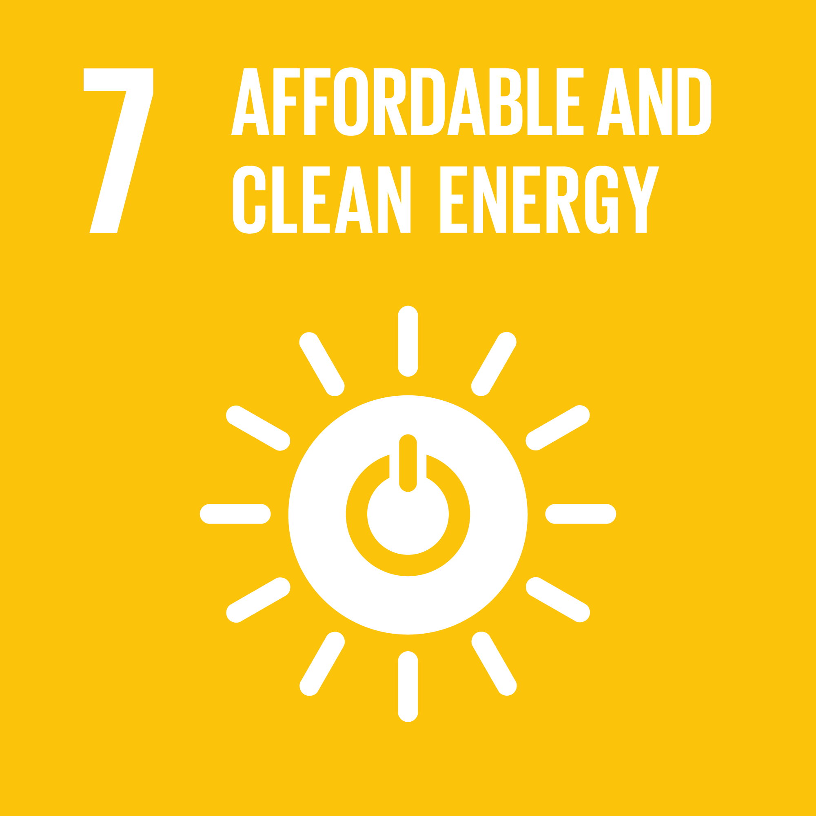
Creation of Housing and Health Index
Domain | Metric | Variables from Data (e.g. Accra) | Assessment / score | Alignment to Sustainable Development Goals (SDGs)
 |  |  |  | Goal | Target | Indicator
I. Structure | Building types / materials | Dwelling type, Floor, Walls, Roof | Good/ Bad |  | 11.1 By 2030, ensure access for all to adequate, safe and affordable housing and basic services and upgrade slums | 11.1.1 Proportion of urban population living in slums, informal settlements or inadequate housing
II. Electricity | Access | Electricity | Good/ Bad |  | 7.1 By 2030, ensure universal access to affordable, reliable and modern energy services | 7.1.1 Proportion of population with access to electricity 7.1.2 Proportion of population with primary reliance on clean fuels and technology
III. Drinking water | Access | Water source, Drinking water, time to get water | Good/ Bad |  | 6.1 By 2030, achieve universal and equitable access to safe and affordable drinking water for all | 6.1.1 Proportion of population using safely managed drinking water services
IV. Sanitation | Access | Toilet | Good/ Bad |  | 6.2 By 2030, achieve access to adequate and equitable sanitation and hygiene for all and end open defecation, paying special attention to the needs of women and girls and those in vulnerable situations | 6.2.1 Proportion of population using safely managed sanitation services, including a hand-washing facility with soap and water
V. Lighting | Source | Lighting source | Good/ Bad
VI. Crowding | Occupants per room | Number Households sharing bedroom, rooms household occupy | Good/ Bad
VII. Household air pollution | Cooking fuel type | Cooking fuel | Good/ Bad |  | 11.6 By 2030, reduce the adverse per capita environmental impact of cities, including by paying special attention to air quality and municipal and other waste management 3.9 By 2030, substantially reduce the number of deaths and illnesses from hazardous chemicals and air, water and soil pollution and contamination | 11.6.1 Proportion of urban solid waste regularly collected and with adequate final discharge out of total urban solid waste generated, by cities 11.6.2 Annual mean levels of fine particulate matter (e.g. PM2.5 and PM10) in cities (population weighted) 3.9.1 Mortality rate attributed to household and ambient air pollution 3.9.2 Mortality rate attributed to unsafe water, unsafe sanitation and lack of hygiene (exposure to unsafe Water, Sanitation and Hygiene for All (WASH) services) 3.9.3 Mortality rate attributed to unintentional poisoning

Slide 19
Preliminary Housing and Health Index Process based on Accra data
Domains | Metric | Accra Data |  |  |  |  | Alignment to SDGs
 |  | Variable | Category | Frequency | Good | Bad | Targets |  | Indicators
I. Structure | Building types / materials | Dwelling type Source: Population and Housing Census, 2010 | Compound house (rooms) | 55.00% |  |  | 11.1 By 2030, ensure access for all to adequate, safe and affordable housing and basic services and upgrade slums |  | 11.1.1 Proportion of urban population living in slums, informal settlements or inadequate housing
 |  |  | Separate house | 16.40%
 |  |  | Semi-detached house | 8.20%
 |  |  | Flat/Apartment | 6.50%
 |  |  | Improvised home (kiosk/container,etc) | 6.20%
 |  |  | Uncompleted building | 3.00%
 |  |  | Huts/Buildings (same compound) | 0.90%
 |  |  | Living quarters attached to office/shop | 0.80%
 |  |  | Other | 0.40%
 |  |  | Tent | 0.20%
 |  | Floor Source: Population and Housing Census, 2010 | Cement/Concrete | 74.40%
 |  |  | Earth/Mud | 4.60%
 |  |  | Ceramic/Porcelain/Granite/Marble tiles | 3.70%
 |  |  | Wood | 3.60%
 |  |  | Terrazzo/Terrazzo tiles | 3.30%
 |  |  | Vinyl tiles | 2.50%
 |  |  | Stone | 0.50%
 |  |  | Other | 0.30%
 |  |  | Burnt brick | 0.20%
Notes:
Could this work in Accra?
Other partner cities?

Slide 20
Domains | Metric | Accra Data |  |  |  |  | SDGs
 |  | Variable | Category | Frequency | Good | Bad | Targets |  | Indicators
I. Structure | Building types / materials | Walls Source: Population and Housing Census, 2010 | Cement blocks/Concrete | 81.10% |  |  | 11.1 By 2030, ensure access for all to adequate, safe and affordable housing and basic services and upgrade slums |  | 11.1.1 Proportion of urban population living in slums, informal settlements or inadequate housing
 |  |  | Wood | 10.30%
 |  |  | Mud brick/Earth | 2.40%
 |  |  | Other | 1.50%
 |  |  | Metal sheet/Slate/Asbestos | 1.30%
 |  |  | Burnt bricks | 0.40%
 |  |  | Landcrete | 0.30%
 |  |  | Stone | 0.20%
 |  |  | Bamboo | 0.10%
 |  |  | Palm leaf/Thatch (grass)/Raffia | 0.10%
 |  | Roof Source: Population and Housing Census, 2010 | Metal sheet | 47.70%
 |  |  | Slate/Asbestos | 41.70%
 |  |  | Cement/Concrete | 3.90%
 |  |  | Roofing tile | 1.70%
 |  |  | Wood | 0.80%
 |  |  | Thatch/Palm leaf or Raffia | 0.80%
 |  |  | Other | 0.70%
 |  |  | Mud/Mud bricks/Earth | 0.30%
 |  |  | Bamboo | 0.20%
Notes:
Could this work in Accra?
Other partner cities?

Slide 21
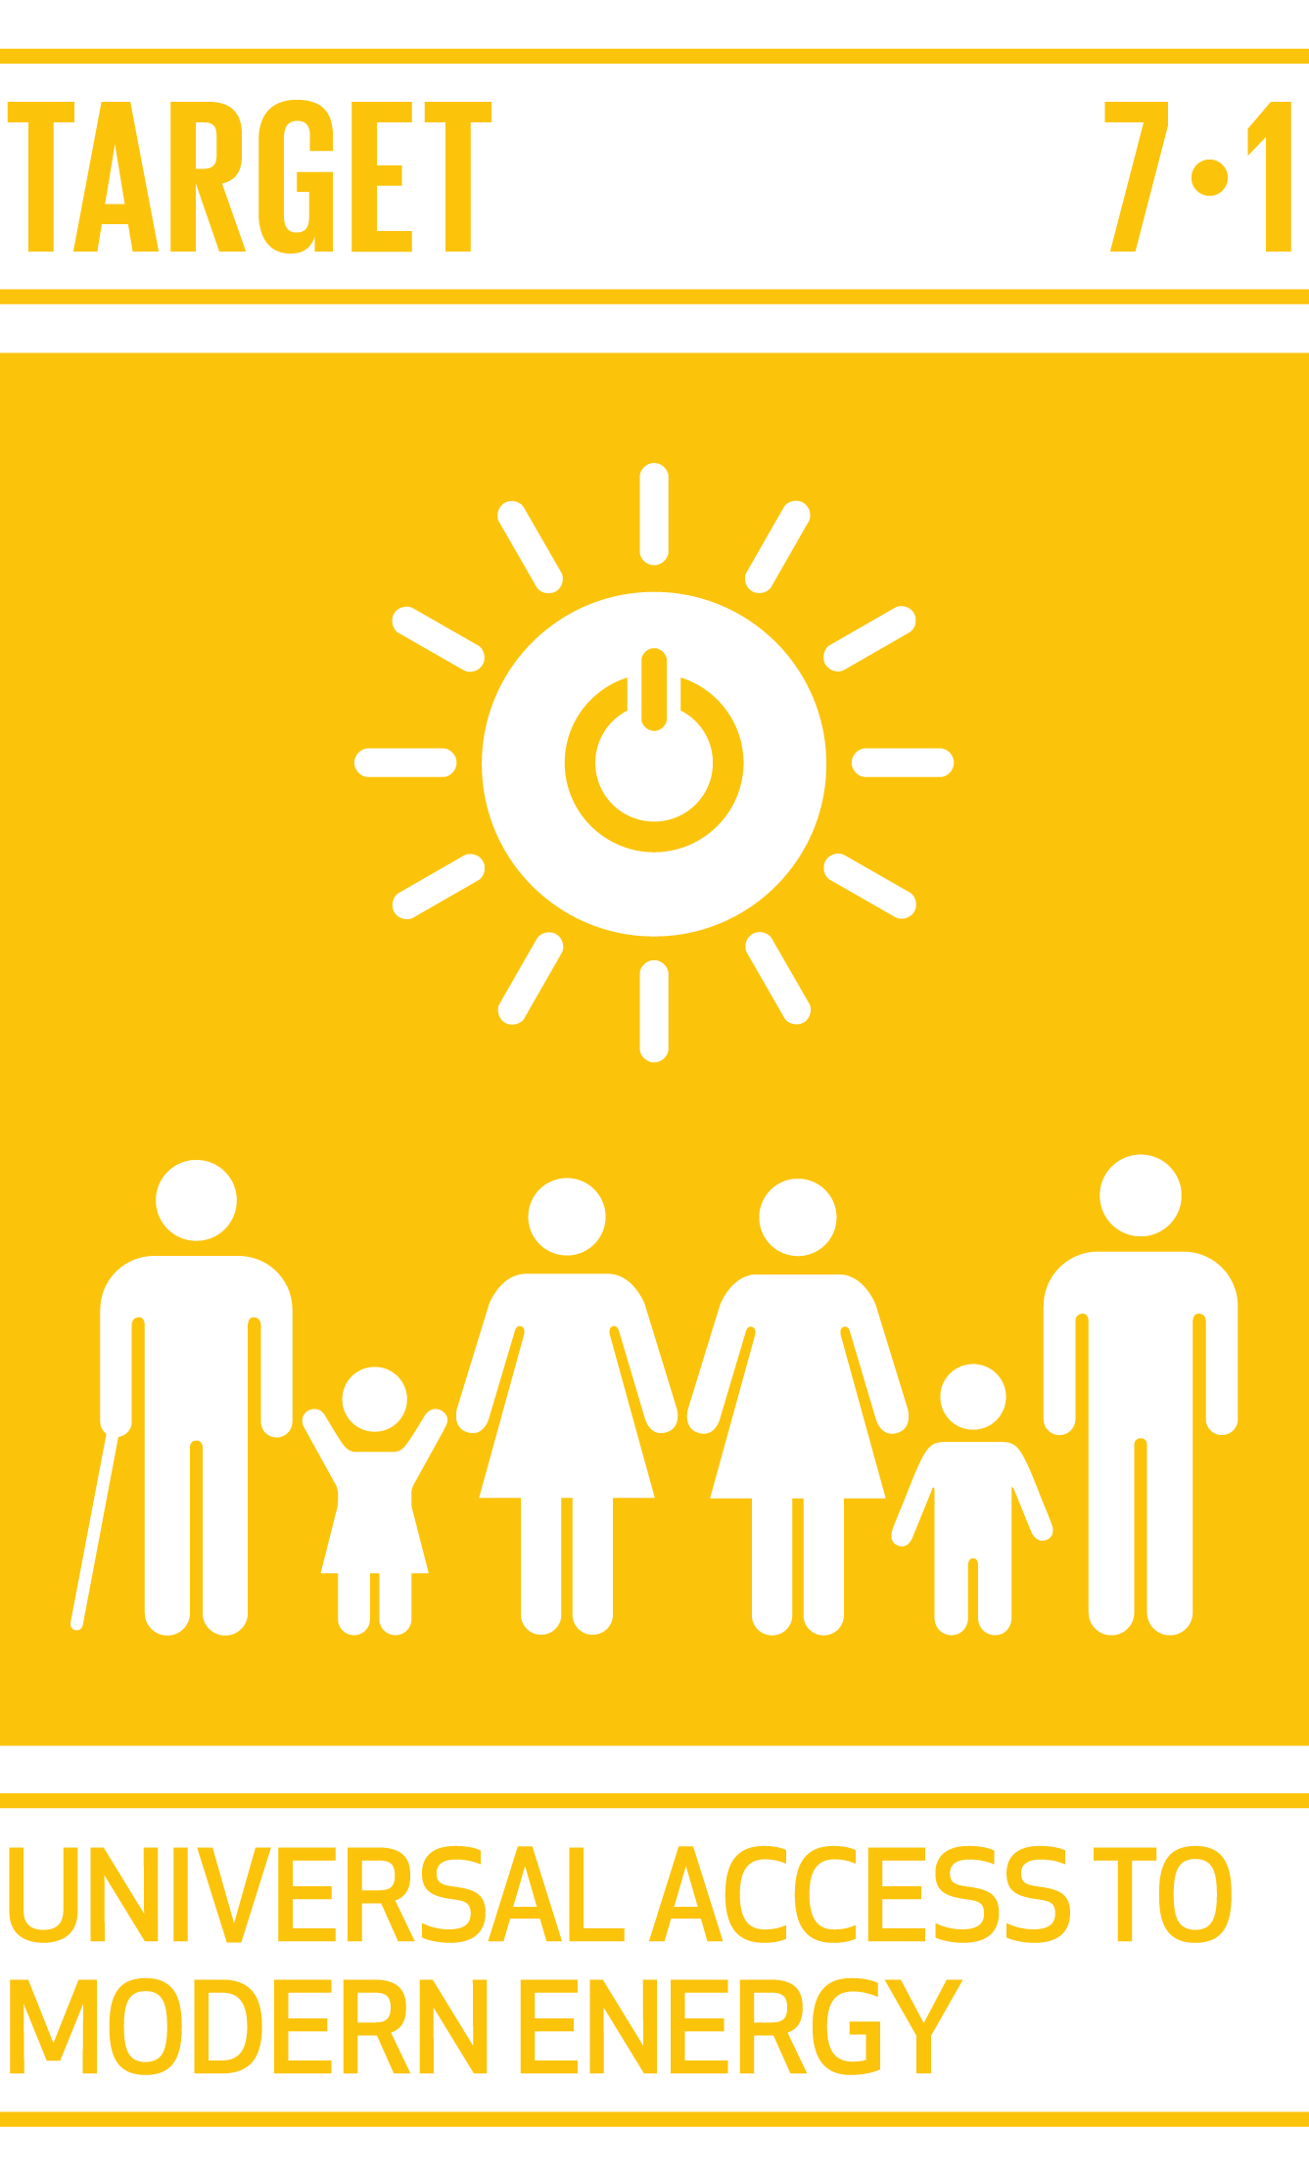
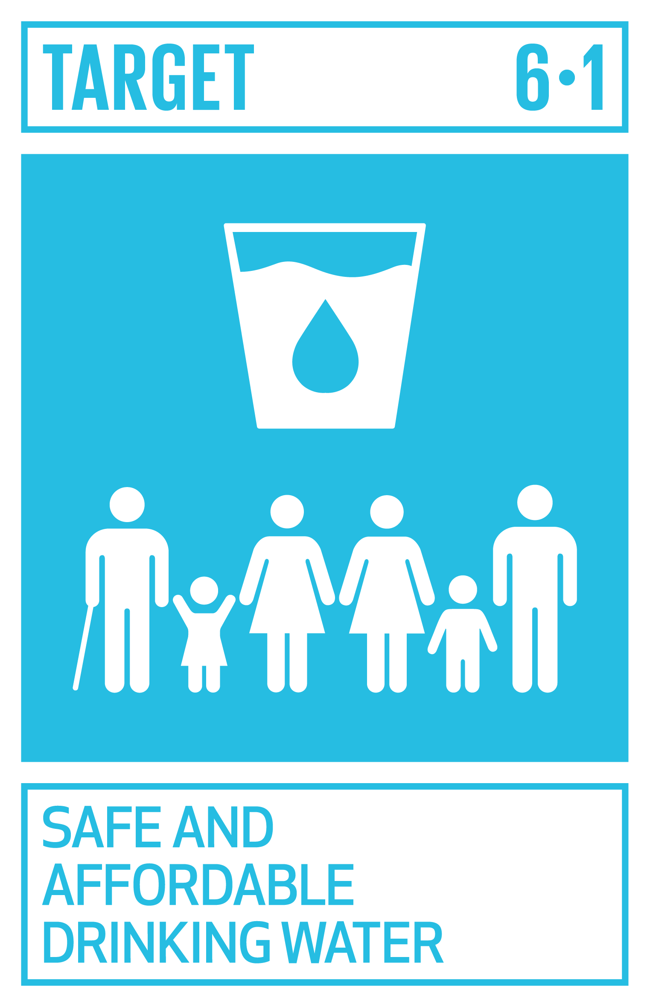
Domains | Metric | Accra Data |  |  |  |  | SDGs
 |  | Variable | Category | Frequency | Good | Bad | Targets |  | Indicators
II. Electricity | Access | Electricity in the household Source: Multiple Indicator Cluster Survey (MICS) in 5 High Densely Populated Localities (Accra), 2010-2011 | Yes | 49.30% |  |  | 7.1 By 2030, ensure universal access to affordable, reliable and modern energy services |  | 7.1.1 Proportion of population with access to electricity 7.1.2 Proportion of population with primary reliance on clean fuels and technology
 |  |  | No | 48.90%
III. Drinking water | Access | Water source Source: Population and Housing Census, 2010 | Pipe-borne outside dwelling | 26.60% |  |  | 6.1 By 2030, achieve universal and equitable access to safe and affordable drinking water for all |  | 6.1.1 Proportion of population using safely managed drinking water services
 |  |  | Unprotected well | 26.10%
 |  |  | Pipe-borne inside dwelling | 26.00%
 |  |  | Public tap/Standpipe | 8.40%
 |  |  | Unprotected spring | 2.10%
 |  |  | Bore-hole/Pump/Tube well | 1.40%
 |  |  | Tanker supply/Vendor provided | 1.00%
 |  |  | Protected well | 0.40%
 |  |  | Protected spring | 0.30%
 |  |  | Other | 0.20%
 |  |  | River/Stream Dugout/Pond/Lake/Dam/Canal | 0.50%
 |  | Drinking water source Source: Population and Housing Census, 2010 | Pipe-borne outside dwelling | 26.60%
 |  |  | Satchet water | 26.10%
 |  |  | Pipe-borne inside dwelling | 26.00%
 |  |  | Public tap/Standpipe | 8.40%
 |  |  | Tanker supply/Vendor provided | 2.10%
 |  |  | Bore-hole/Pump/Tube well | 1.40%
 |  |  | Bottled water | 1.00%
 |  |  | Protected well | 0.40%
 |  |  | Protected spring | 0.30%
 |  |  | River/Stream | 0.20%
 |  |  | Rain water , nprotected well Unprotected spring Dugout/Pond/Lake/Dam/Canal | 0.50%
Notes:
Could this work in Accra?
Other partner cities?

Slide 22
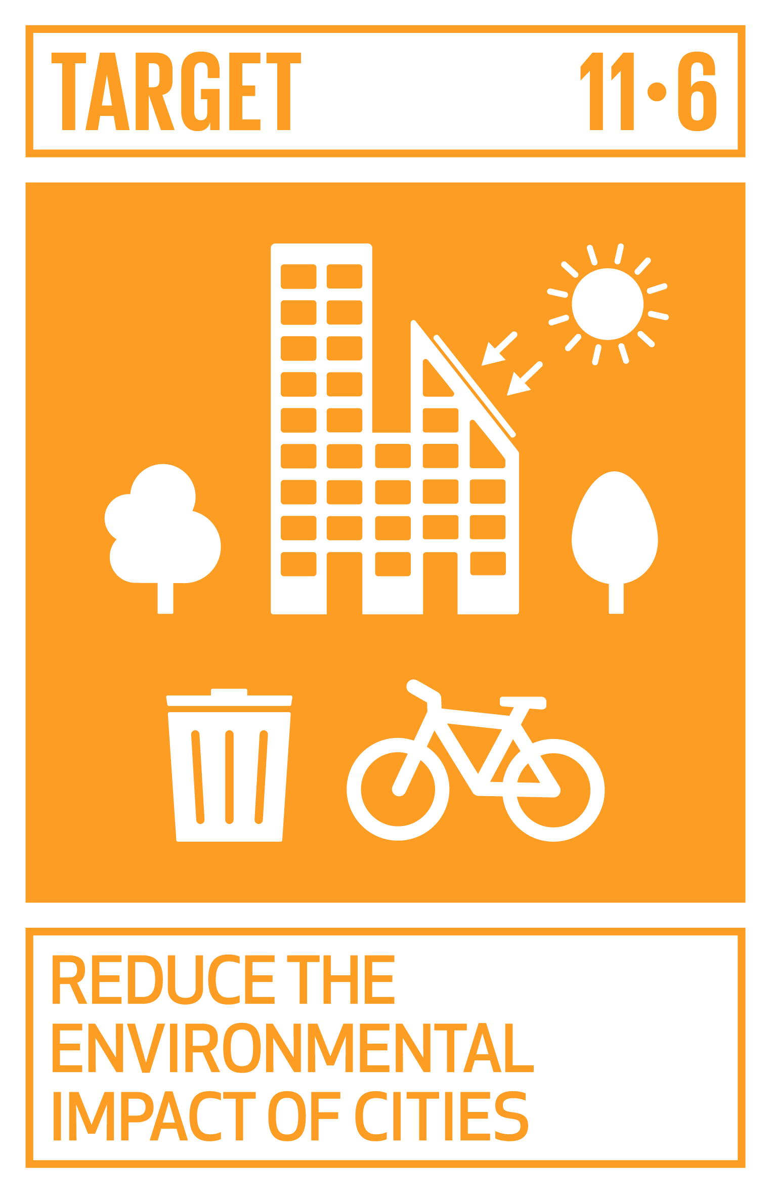
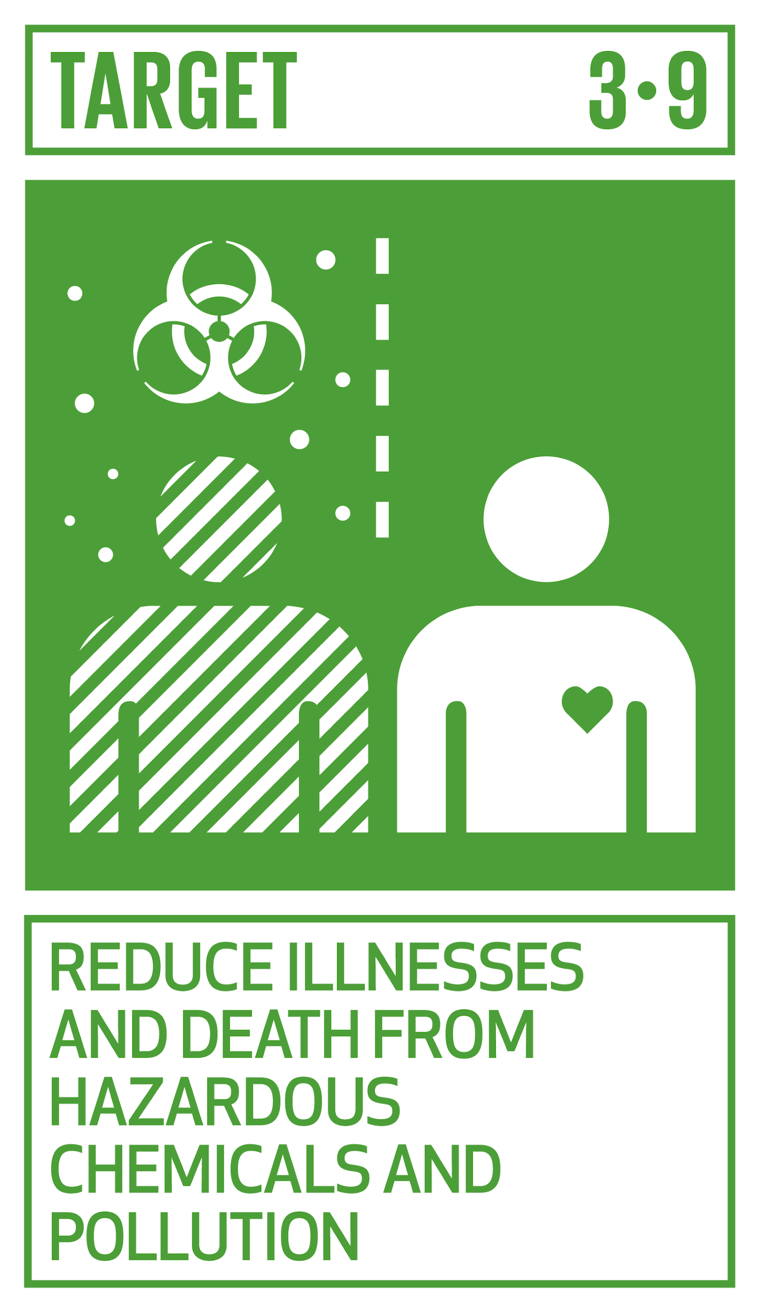
Domains | Metric | Accra Data |  |  |  |  | SDGs
 |  | Variable | Category | Frequency | Good | Bad | Targets |  | Indicators
IV. Sanitation | Access | Toilet Source: Population and Housing Census, 2010 | Public toilet (WC,KVIP,Pit,Pan, etc) | 33.10% |  |  | 6.1 By 2030, achieve universal and equitable access to safe and affordable drinking water for all |  | 6.1.1 Proportion of population using safely managed drinking water services
 |  |  | W.C. | 30.10%
 |  |  | KVIP | 13.00%
 |  |  | Pit latrine | 8.80%
 |  |  | No facilities (bush/beach/field) | 5.40%
 |  |  | Bucket/Pan | 2.30%
 |  |  | Other | 0.50%
VII. Household air pollution | Cooking fuel | Cooking fuel Source: Population and Housing Census, 2010 | Charcoal | 42.20% |  |  | 11.6 By 2030, reduce the adverse per capita environmental impact of cities, including by paying special attention to air quality and municipal and other waste management 3.9 By 2030, substantially reduce the number of deaths and illnesses from hazardous chemicals and air, water and soil pollution and contamination |  | 11.6.1 Proportion of urban solid waste regularly collected and with adequate final discharge out of total urban solid waste generated, by cities 11.6.2 Annual mean levels of fine particulate matter (e.g. PM2.5 and PM10) in cities (population weighted) 3.9.1 Mortality rate attributed to household and ambient air pollution 3.9.2 Mortality rate attributed to unsafe water, unsafe sanitation and lack of hygiene (exposure to unsafe Water, Sanitation and Hygiene for All (WASH) services) 3.9.3 Mortality rate attributed to unintentional poisoning
 |  |  | Gas | 39.60%
 |  |  | None, no cooking | 6.70%
 |  |  | Wood | 2.00%
 |  |  | Kerosene | 1.10%
 |  |  | Electricity | 0.90%
 |  |  | Other | 0.20%
 |  |  | Saw dust | 0.20%
 |  |  | Animal waste | 0.10%
 |  |  | Crop residue | 0.10%
Notes:
Could this work in Accra?
Other partner cities?

Slide 23
Next steps
Upcoming calls
Oct 10- need to reschedule call due to Accra Workshop
Nov 14
Dec 12

Slide 24
Thank You

Slide 25
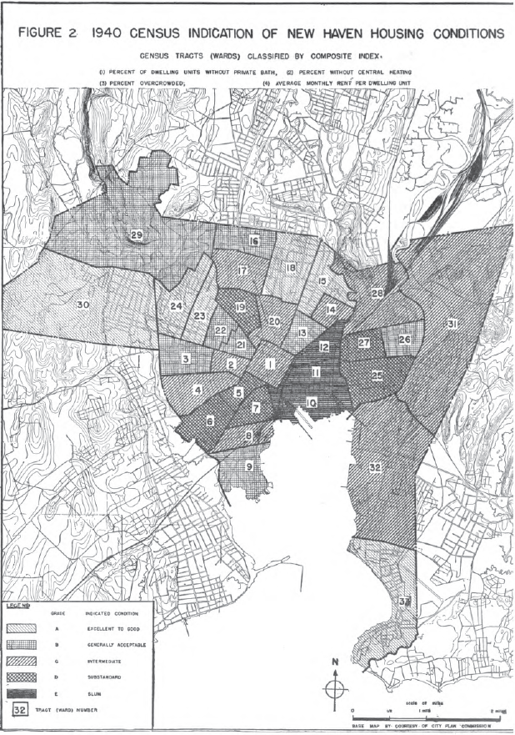
Historical example of housing quality assessment (1940s) used for post war housing program in US
Appraisal form for scoring deficiency items of dwelling units.
Main objectives:
Slum identification to base the program for slum clearance, rehousing, conservation of blighted areas, and improvement of legal housing controls.
1. Each dwelling unit is rated by totaling the penalty scores for all deficiency items of the unit and of the building structure.
2. Environmental scores are computed blocks, with some items (such as exposure to traffic hazard) varying as between the four street frontages of block.
3. Total housing quality expressed adding to each dwelling unit score the environmental score of the street frontage on which the dwelling lies. The term "housing quality" used only when dwelling scores and environmental scores have been combined.
4. For comparison, areas are graded from A-E according to the scores
Grade range:
A - excellent to good condition
B – generally acceptable condition
C – Intermediate condition
D – Substandard condition
E – Slum condition
American Public Health Association. Committee on the Hygiene of Housing, Q. P. H. A. C. o. t. H. o. H. (1945). An appraisal method for measuring the quality of housing: a yardstick for health officers, housing officials and planners. New York, N.Y.
Notes:
This survey, sponsored early in 1944 by the local Housing Authority as a part of its post-war planning program, was carried out in cooperation with the New Haven Health Department and City Plan Commission, under direction of the Committee's Technical Secretary. Its purpose was to supply the government and people of the city with the facts upon which they can base an integrated longterm program for slum clearance, rehousing, conservation of blighted areas, and improvement of legal housing controls.
On the basis of the Census findings (including further study of the block data) and field reconnaissance, three districts were selected for appraisal. These are shown in Figure 3. District II contains the
three wards of presumptive slums, district I the three substandard wards adjoining to the west. District III covers one of the substandard wards to the east and the significant portions of the other."
The area between districts I and II is occupied primarily by the central business district and Yale University. One of the major industrial sections borders districts II and III.

