Slide 1
Social Media Scan : Accra housing on Twitter
An overview and preliminary findings
Camilla Audia
Frans Berkhout

Slide 2
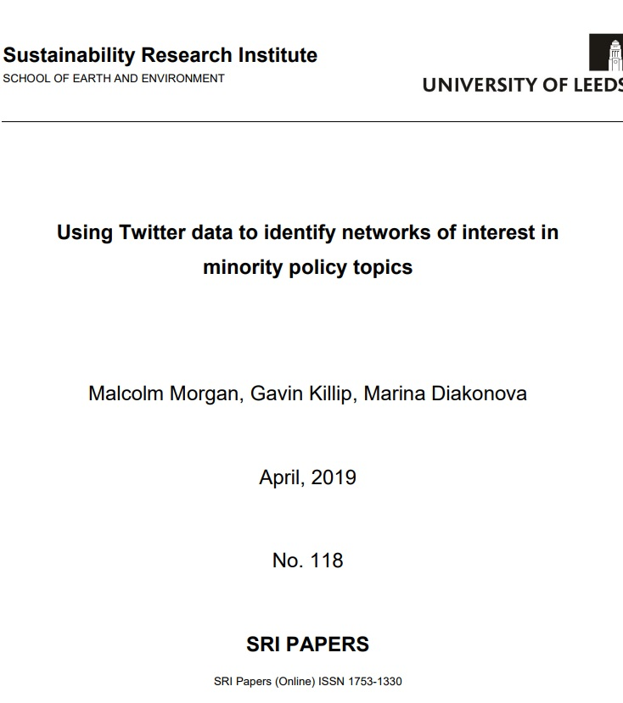
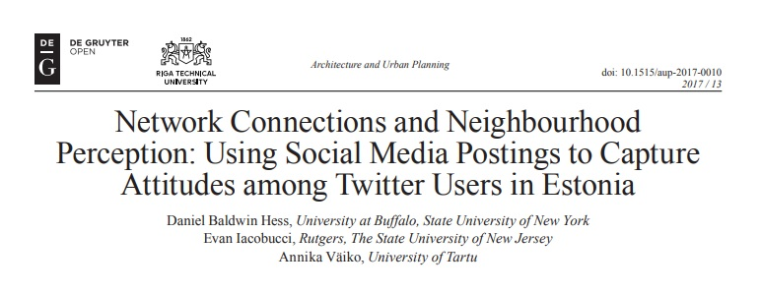
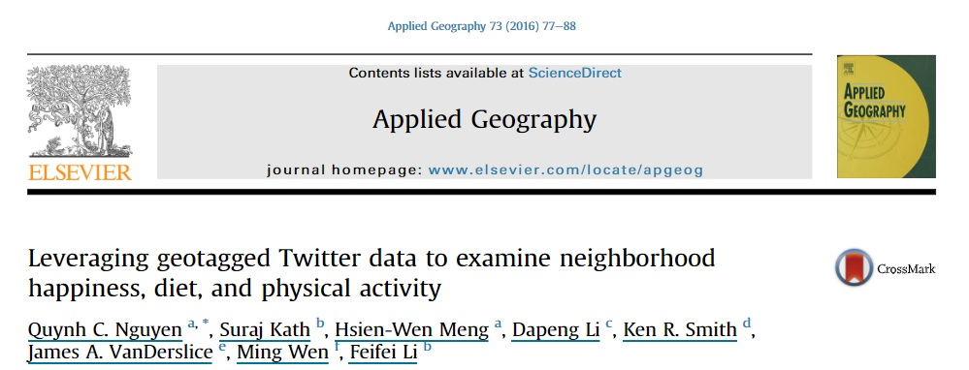
Why?
Co-production
processes within
Pathways
Any co-production process is in fact limited in time and resources and taking place within an ongoing background of interactions
Pathways is very policy-focussed but co-production also aims to include voices from society
Twitter offers a way to get people’s insight from their profiles in contrast to traditional ways of obtaining information about perceptions (SSI, questionnaires…) as well as gauge attention towards specific topics including attitudes towards urban life
Co-production in wider urban social, cultural and political context

Slide 3
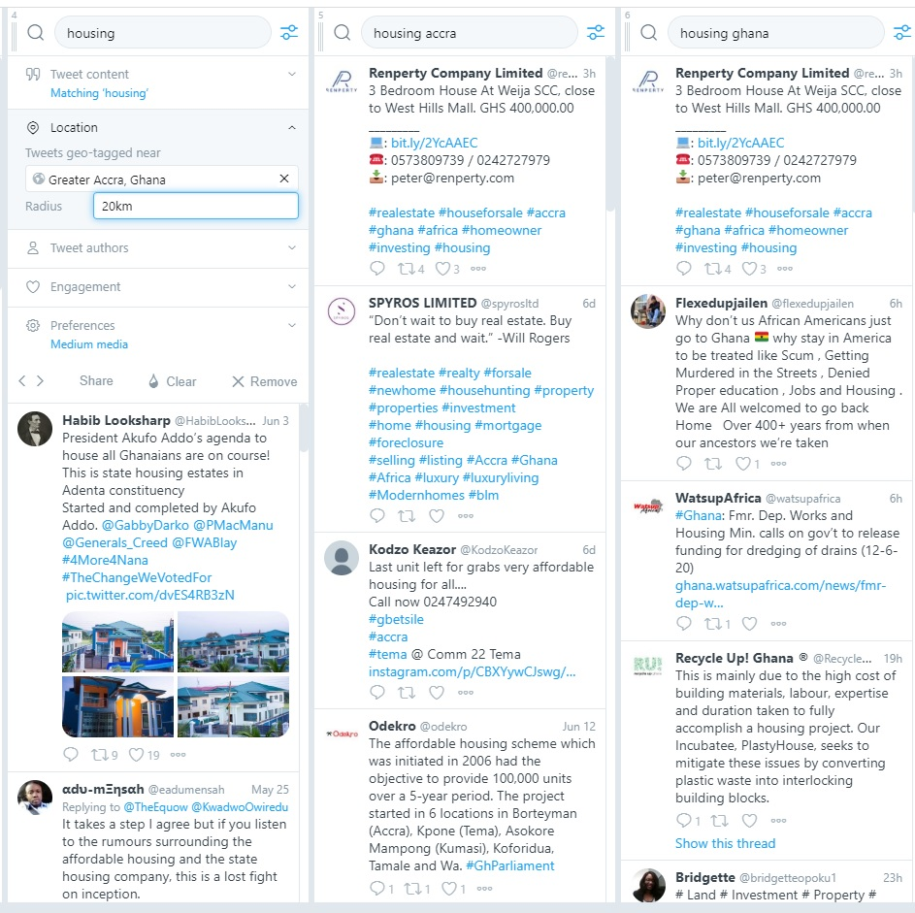
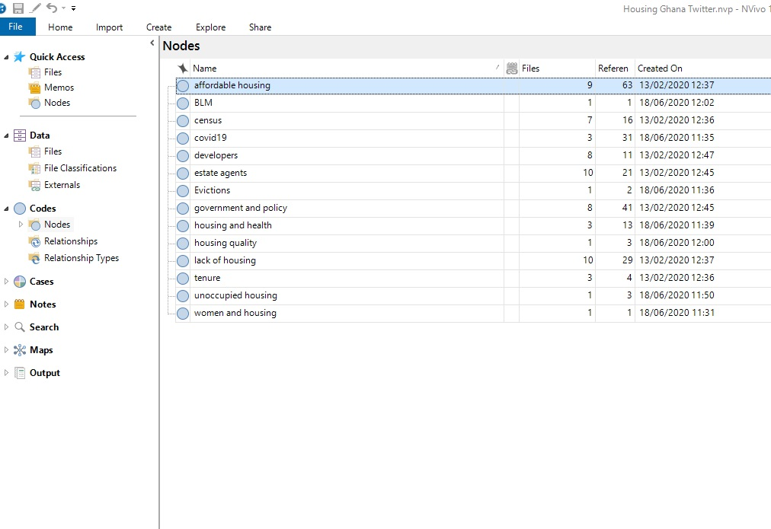
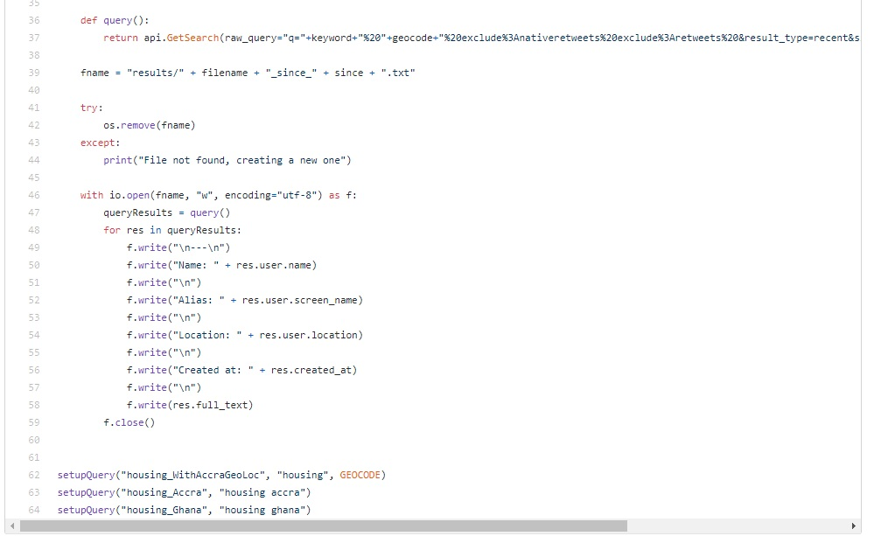
How?
Manual monitoring of Twitter hashtags via TweetDeck:
“housing” geotagged: within 20km of Greater Accra
“housing Accra”
“housing Ghana”
Automated API scraping (Python script)
Nvivo coding and analysis

Slide 4
Themes (NVivo coding)
About 800 tweets total – 500 thematically correct – 200 relevant.
Qualitatively coded into different categories according to their content
Affordable Housing (64)
Government and Policy (49)
Estate agents/developers (34)
Covid19 (31)
Lack of Housing (29)
Census (16)
Housing and Health / Housing quality (19)
Minor references to: tenure (4), unoccupied housing (3), evictions (2)

Slide 5
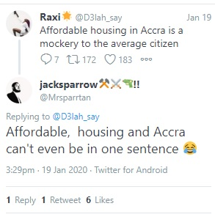
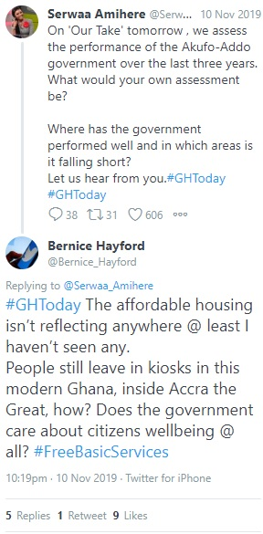
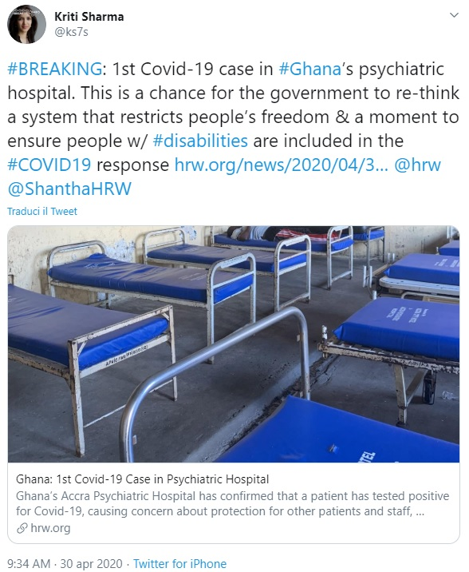
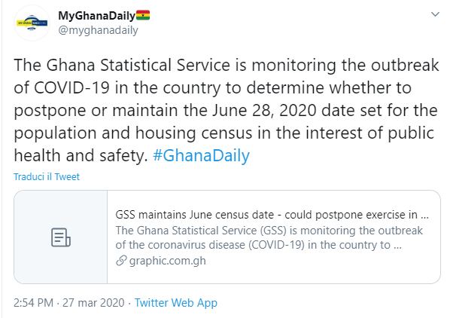
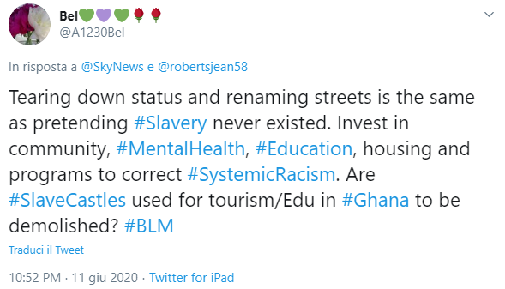
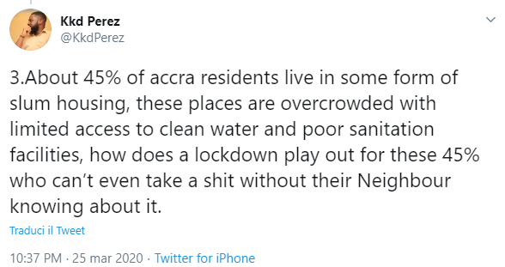
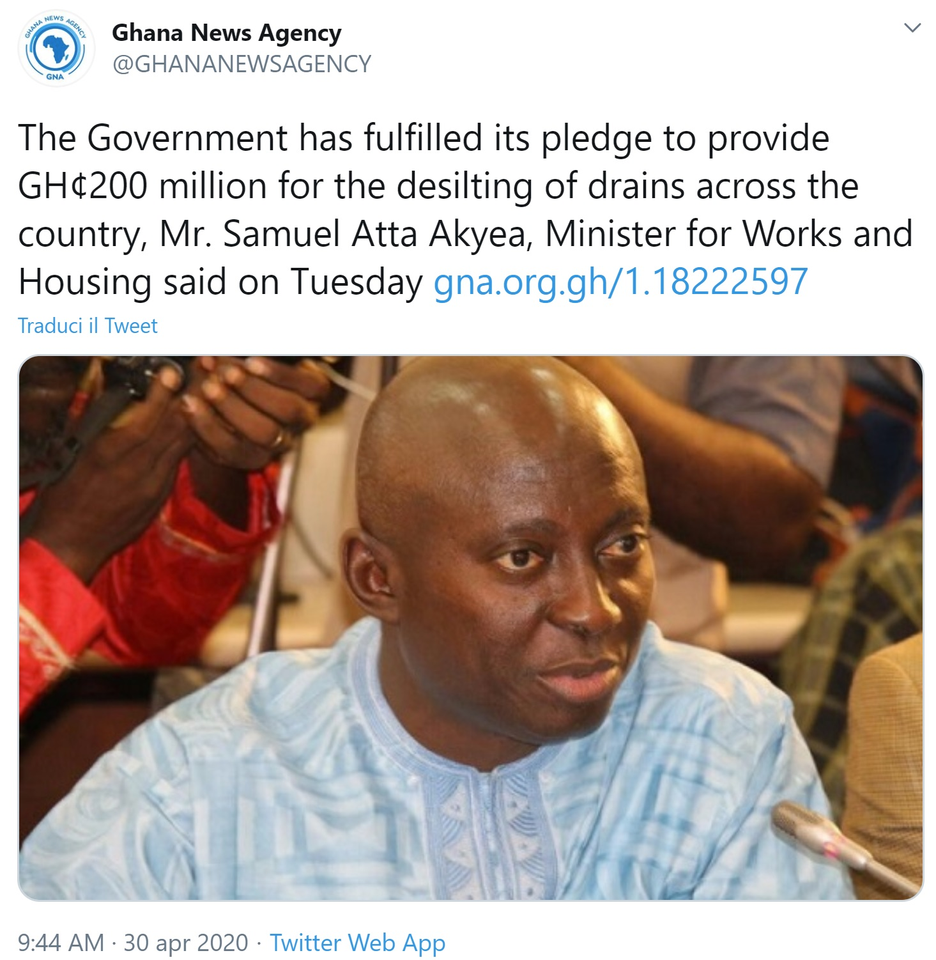
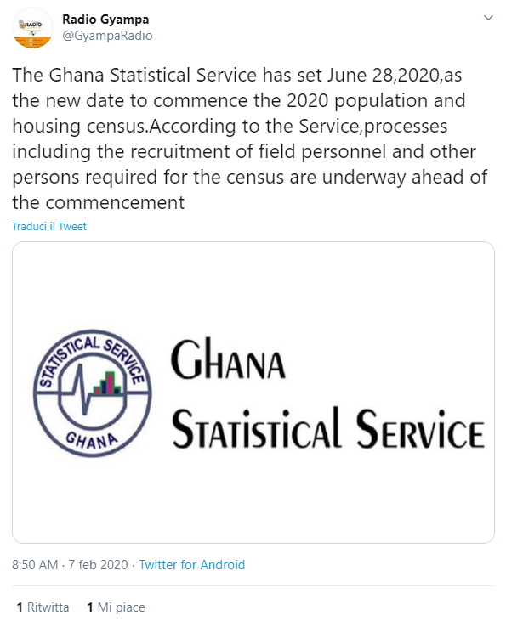
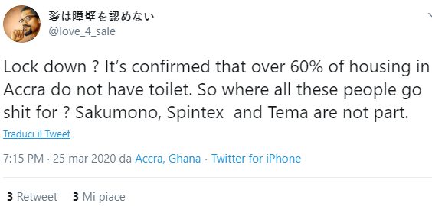
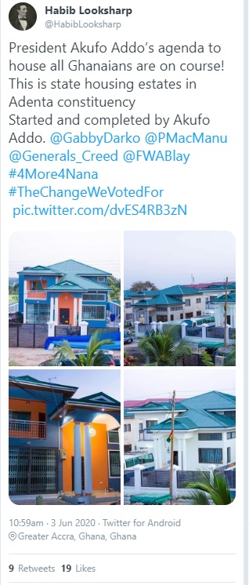
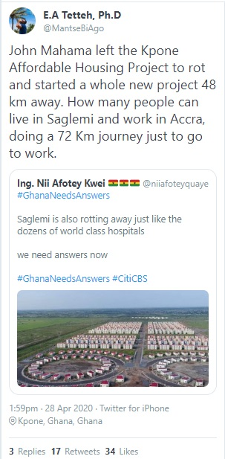
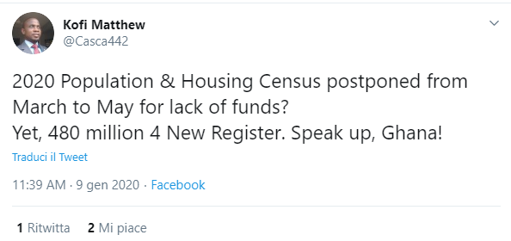
Terms of the debate
News and comments on policies / government actions
Raising issues of affordable housing
Housing in relations to current news/debates
Covid-19 and health/housing quality
BLM
Discussions on census

Slide 6
Emerging interpretations of data
Every week there are 20-30 tweets that are relevant
Affordable Housing / Government and policy debate:
People criticising government action (or lack of action) on prices. Strong sentiment that “affordable” is not affordable in reality.
Politicising the debate
Current projects and new projects
Covid-19 offering links between housing, health and inequalities
Different uses for existing empty houses (empty as not affordable)
Use of budgets
Projects being finalised for imminent use
Census
Debate around starting date
Links with electoral register
Estate agents / Land developers

Slide 7
Initial Reflections
Interesting tool and fascinating research: but is it useful?
Elaborating a strategy for analysis (research questions/new coding)
Ethics
Limitations
Potential for further analysis: quantitative sentiment analysis over perceptions? Geotagging analysis? Different cities / hashtags? Languages?

Slide 8
Questions?
Thank you
camilla.audia@kcl.ac.uk
frans.berkhout@kcl.ac.uk

